Slide 1


High-Level Design
Alayans –Meeting Room Booking System

Slide 2
Revision History
Rev No. | MODIFIED BY | MODIFIED DATE | REMARKS | PRELIMINARY REVIEW & APPROVAL | DATE REVIEWED | FINAL REVIEW & APPROVAL | DATE APPROVED
1.00 | Alba, Angela Monique | 2024/09/05 | Initial Creation | Last Name, First Name | yyyy/mm/dd | Last Name, First Name | yyyy/mm/dd

Slide 3
SCREEN DETAILS

Slide 4
Screen List
Screen | Description | REMARKS
1.0 Login | The Login Screen lets users enter credentials, shows errors for issues, and redirects to the view page upon success.
2.0 Logout | The Logout Screen prompts users with a confirmation modal to either cancel or proceed, ending the session and redirecting to the login screen.
3.0 Create Booking/ Recurring Booking | The Create Booking process involves clicking a button, entering booking details, validating inputs, and then saving or canceling the booking.
4.0 Edit Booking | The Edit Booking process lets users select a booking, update details in a modal, validate information, and either save changes or cancel.
5.0 Cancel Booking | To cancel a booking, select it, open a confirmation modal, and either delete the booking or close the modal to retain it.
6.0 View Bookings | The View Bookings screen displays all bookings with details and provides options to edit or cancel each booking, redirecting to the respective screen when selected.
7.0 View Notifications | The View Notifications screen shows a list of notifications, displays full details in a modal when clicked, and allows deletion with a red X icon, which refreshes the list.
8.0 Settings and Preferences | The Settings and Preferences screen lets users adjust notification preferences, set a default booking duration, and save these settings.
9.0 View Calendar | The View Calendar screen displays a monthly calendar, marking booked dates, and allows booking creation for future dates while showing an error for past dates.
10.0 Create Booking via Calendar | The Create Booking via Calendar process opens a modal from a selected date to enter and validate details, then saves and refreshes the calendar or cancels.
11.0 Add User | The Add User process involves opening a modal to enter and validate user details, saving if valid, refreshing the View Users screen, or closing the modal without saving.

Slide 5
Screen List
Screen | Description | REMARKS
12.0 Edit User | The Edit User process allows updating user details in a modal, validating inputs, and either saving changes or closing the modal without saving.
13.0 Delete User | The Delete User process includes confirming the deletion in a modal and either deleting the user or canceling the action.
14.0 View Users | The View Users screen displays all users with their details and provides options to edit or delete, redirecting to the respective screen when selected.
15.0 Add Room | The Add Room process opens a modal to input and validate room details, then saves and refreshes the View Rooms screen or cancels without saving.
16.0 Edit Room | The Edit Room process includes selecting a room, updating details in a modal, and either saving changes or closing the modal without saving.
17.0 Delete Room | The Delete Room process involves selecting a room, confirming deletion in a modal, and either deleting the room or canceling the action.
18.0 View Rooms | The View Rooms screen displays all rooms with their details and provides options to edit or delete, redirecting to the respective screen when selected.
19.0 Booking Summary | The View Bookings screen allows filtering by room, date, and user, applies filters to display results, and includes options to reset filters and view all bookings.
20.0 Room Usage Report | The Room Usage Report screen lets users select a room and date range, generate a report with bookings and peak usage charts if valid, and export the report to a file.
21.0 Add Account - Superadmin | The Add Account process involves entering user details in a modal, validating them, saving the account, and refreshing the View Accounts screen or canceling.
22.0 Edit Account - Superadmin | The Edit Account feature updates user details in a modal, validates inputs, and either saves changes or cancels.

Slide 6
Screen List
Screen | Description | REMARKS
23.0 Delete Account - Superadmin | The Delete Account feature involves confirming the deletion in a modal and either deleting the user or canceling the action.
24.0 View Accounts - Superadmin | The View Accounts screen shows all users, with options to edit or delete, and redirects to the appropriate management screens.
25.0 View Bookings - Superadmin | The View Bookings feature lets the Superadmin filter, view, edit, or delete bookings and navigate to booking creation or management screens.

Slide 7
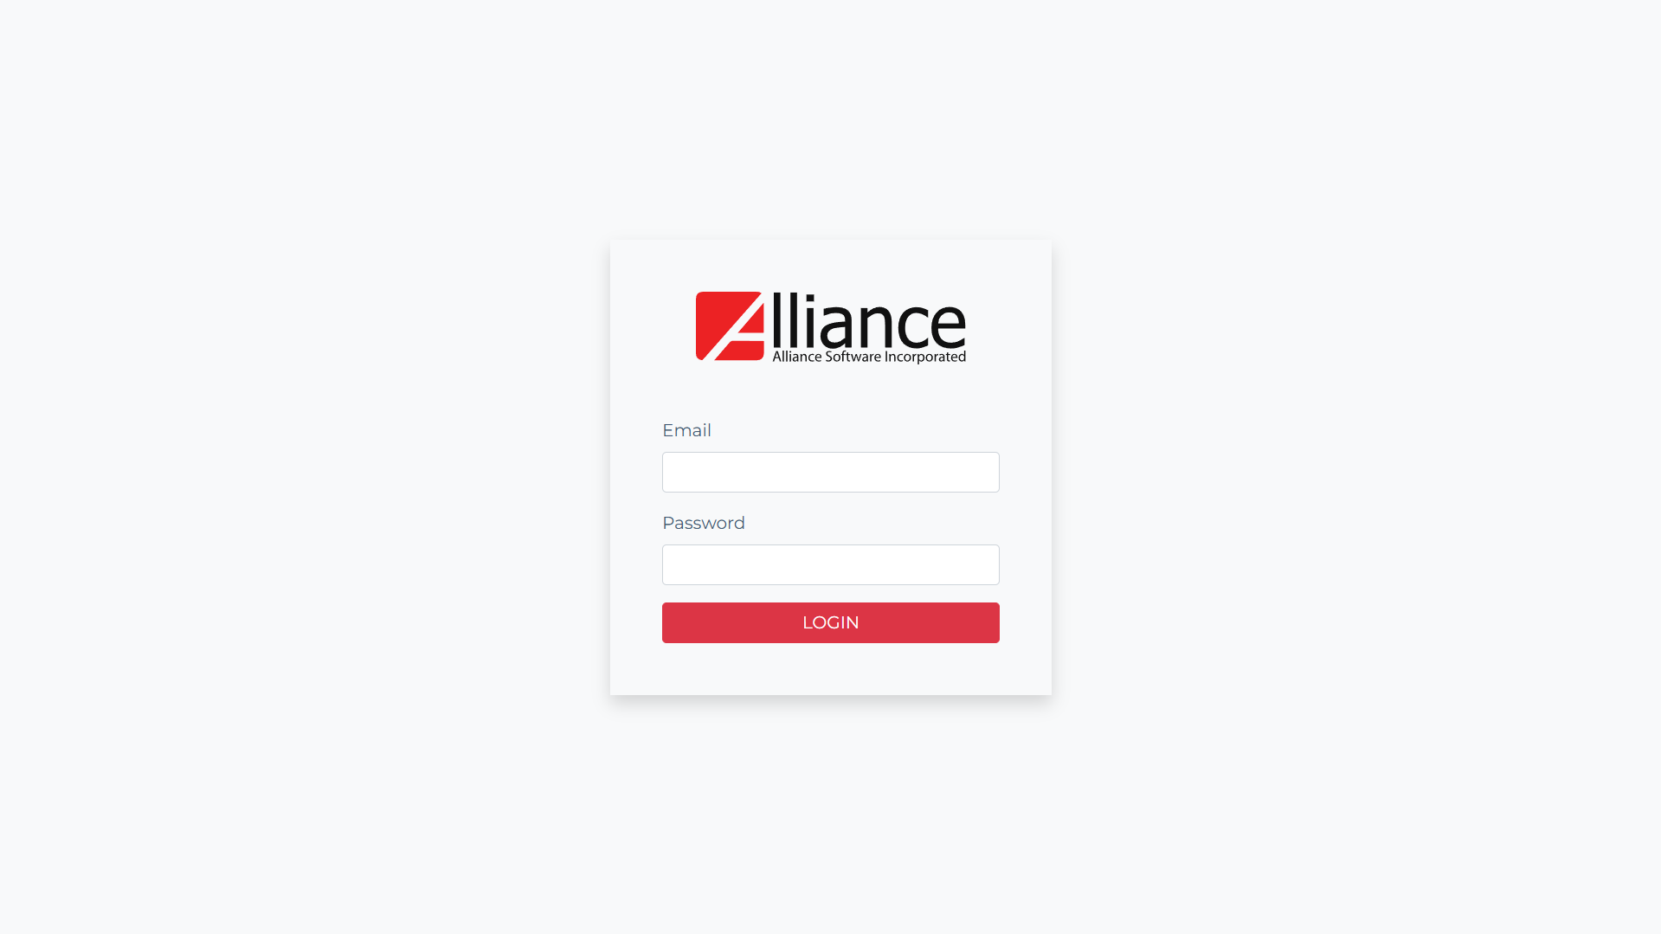
1.0 Login

Slide 8
1.0 Login Logic
Login
Username
Input field for user's username.
Password
This is the password of the user
Input field for user's password (masked characters).
Login Button
Onclick
Check if input fields are empty.
Display error message: "Username and password are required.“
If username and password are incorrect:
Display error message: "The username or password is incorrect.“
If username is a registered user account:
Redirect to View Page.
Else:
Display error message: "User Account does not exist."

Slide 9
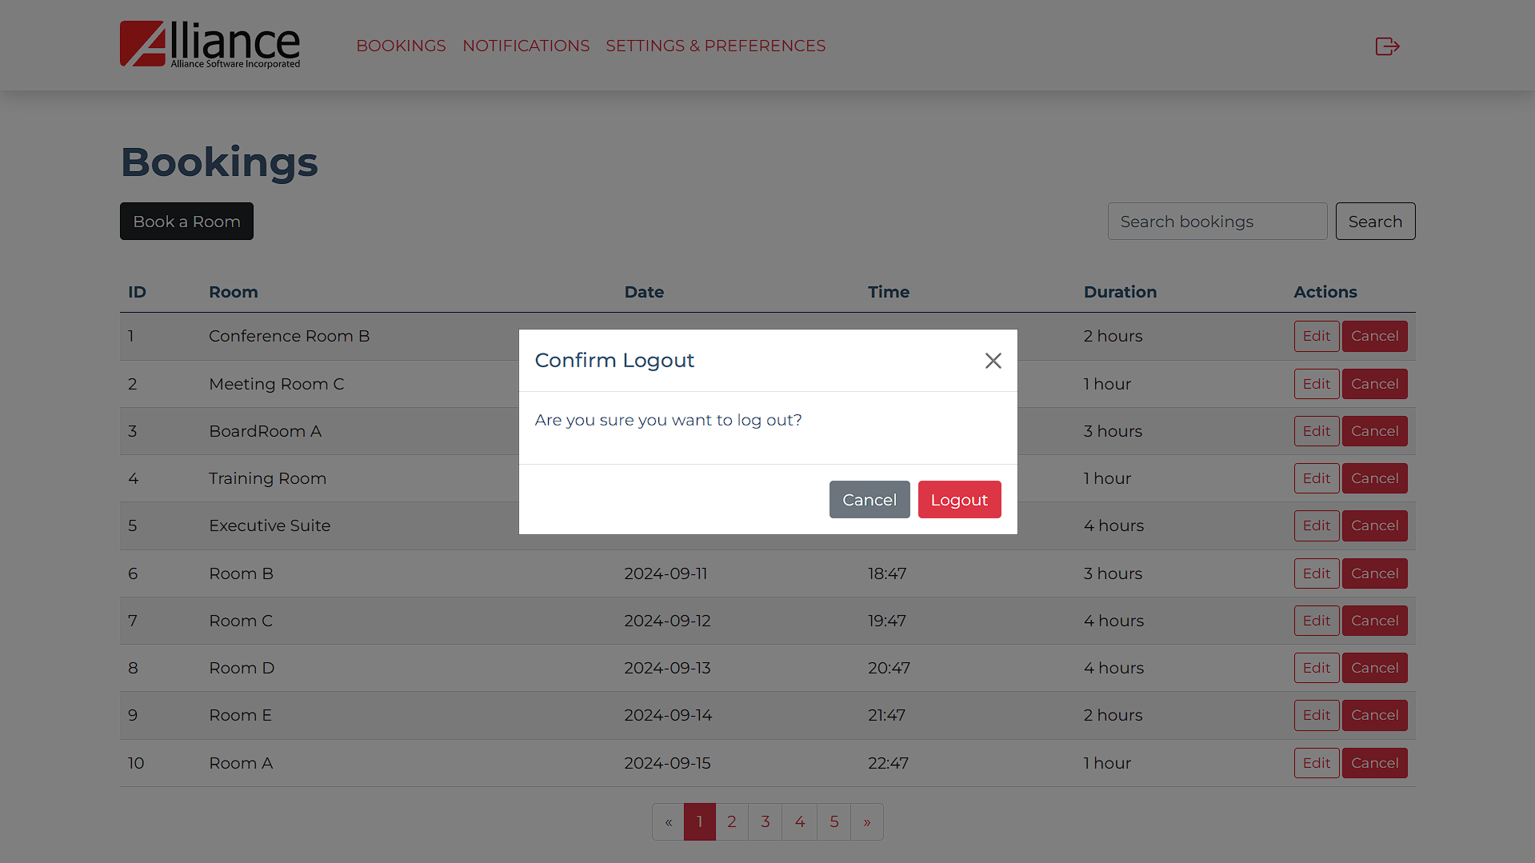
2.0 Logout

Slide 10
2.0 Logout Logic
Logout
Logout Icon
Onclick
Display confirmation modal
Display message "Are you sure you want to logout?“
Logout Button
Onclick
Clear user session or token.
Redirect to Login Screen.
Cancel Button
Onclick
Close modal

Slide 11
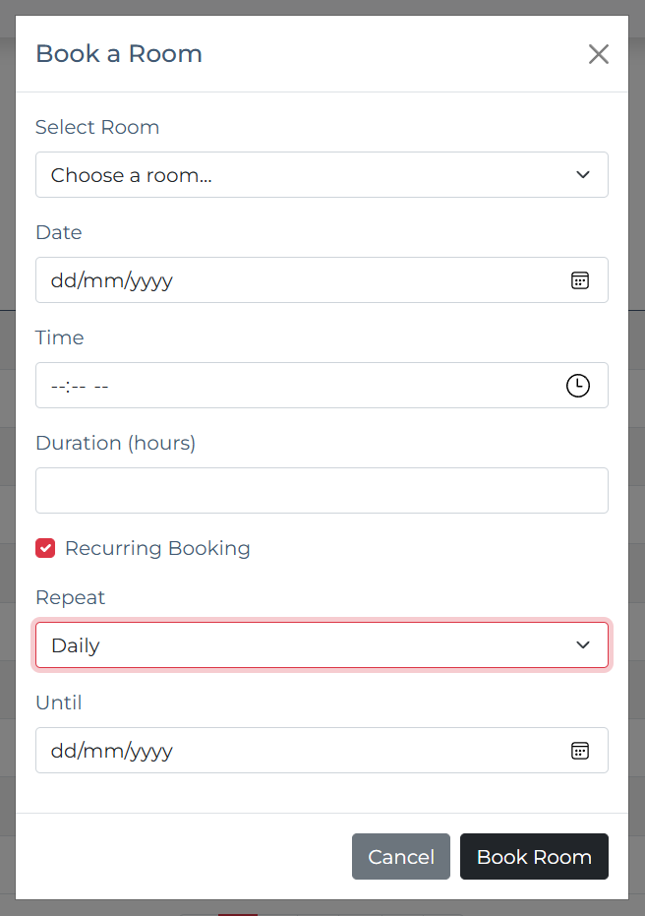
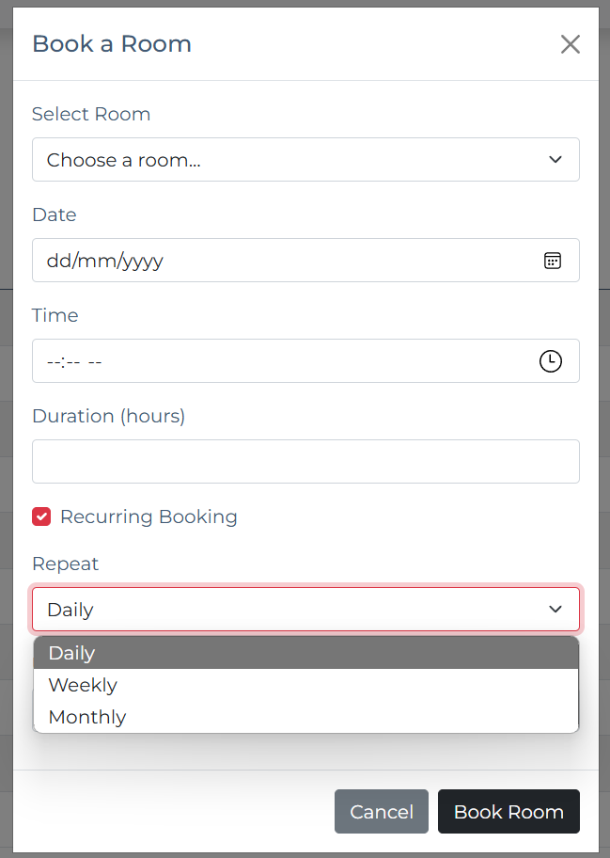
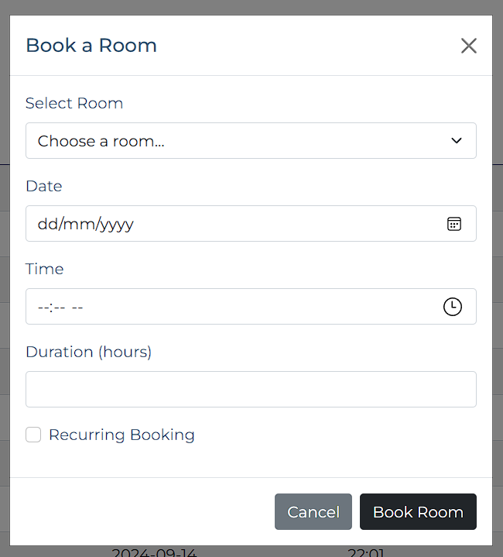
3.0 Create Booking/Recurring Booking

Slide 12
3.0 Create Booking/Recurring Booking Logic
Create Booking
Book a Room Button
Onclick
Display modal to input booking details:
Select Room
Dropdown to choose a room.
Date
Input field for booking date.
Time
Input field for booking time.
Duration
Input field for booking duration.
Recurring Booking Checkbox
Checkbox with label "Recurring booking.“
If checked, display additional inputs:
Repeat
Dropdown with options: Daily, Weekly, Monthly
Until
Date input for end date of the recurring booking.
Book Room Button
Onclick
Check if required fields are empty.
Display error message "All fields are required.“
If recurring booking is selected
Validate the repeat frequency and end date. Ensure the "Until" date is after the initial booking date.
If all validations pass
Save booking details to the database.
Close the modal.
Cancel Button
Onclick
Close the modal without saving changes.

Slide 13
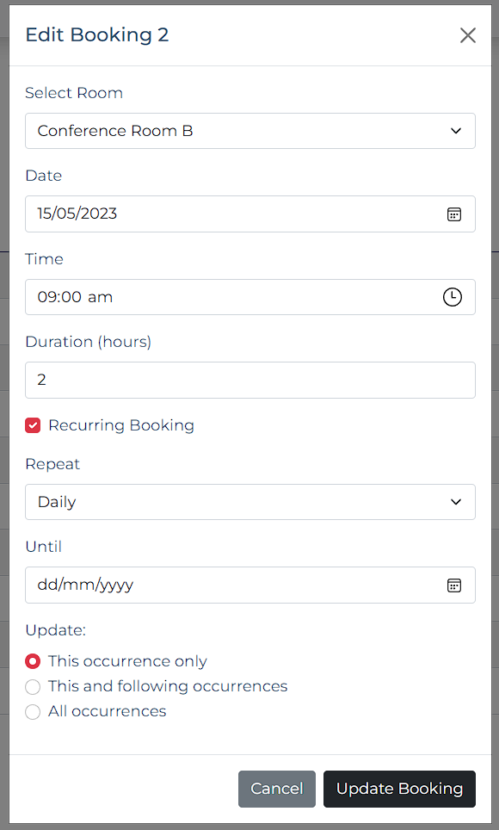
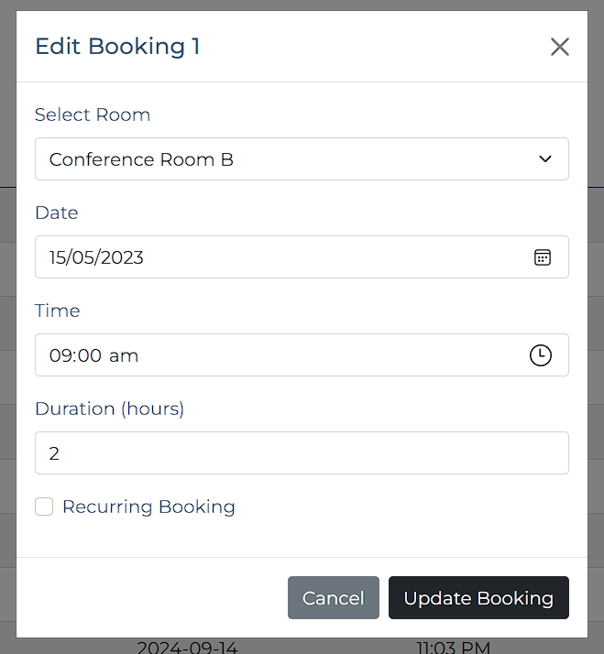
4.0 Edit Booking

Slide 14
4.0 Edit Booking Logic
Edit Booking
Booking List
Select booking to cancel.
Edit Button
Onclick
Display modal to input booking details:
Select Room
Dropdown to choose a room. (prefilled)
Date
Input field for booking date. (prefilled)
Time
Input field for booking time. (prefilled)
Duration
Input field for booking duration. (prefilled)
Recurring Booking Checkbox
Checkbox with label "Recurring booking." (checked if the original booking is recurring)
If checked, display additional inputs:
Repeat
Dropdown with options: Daily, Weekly, Monthly (prefilled)
Until
Date input for end date of the recurring booking. (prefilled)
Update Booking Button
Onclick
Check if required fields are empty.
Display error message "All fields are required.“
If recurring booking is selected
Validate the repeat frequency and end date. Ensure the "Until" date is after the initial booking date.
If all validations pass
Close the modal and redirect to the View Bookings screen.
Cancel Button
Onclick
Close the modal without saving changes.

Slide 15
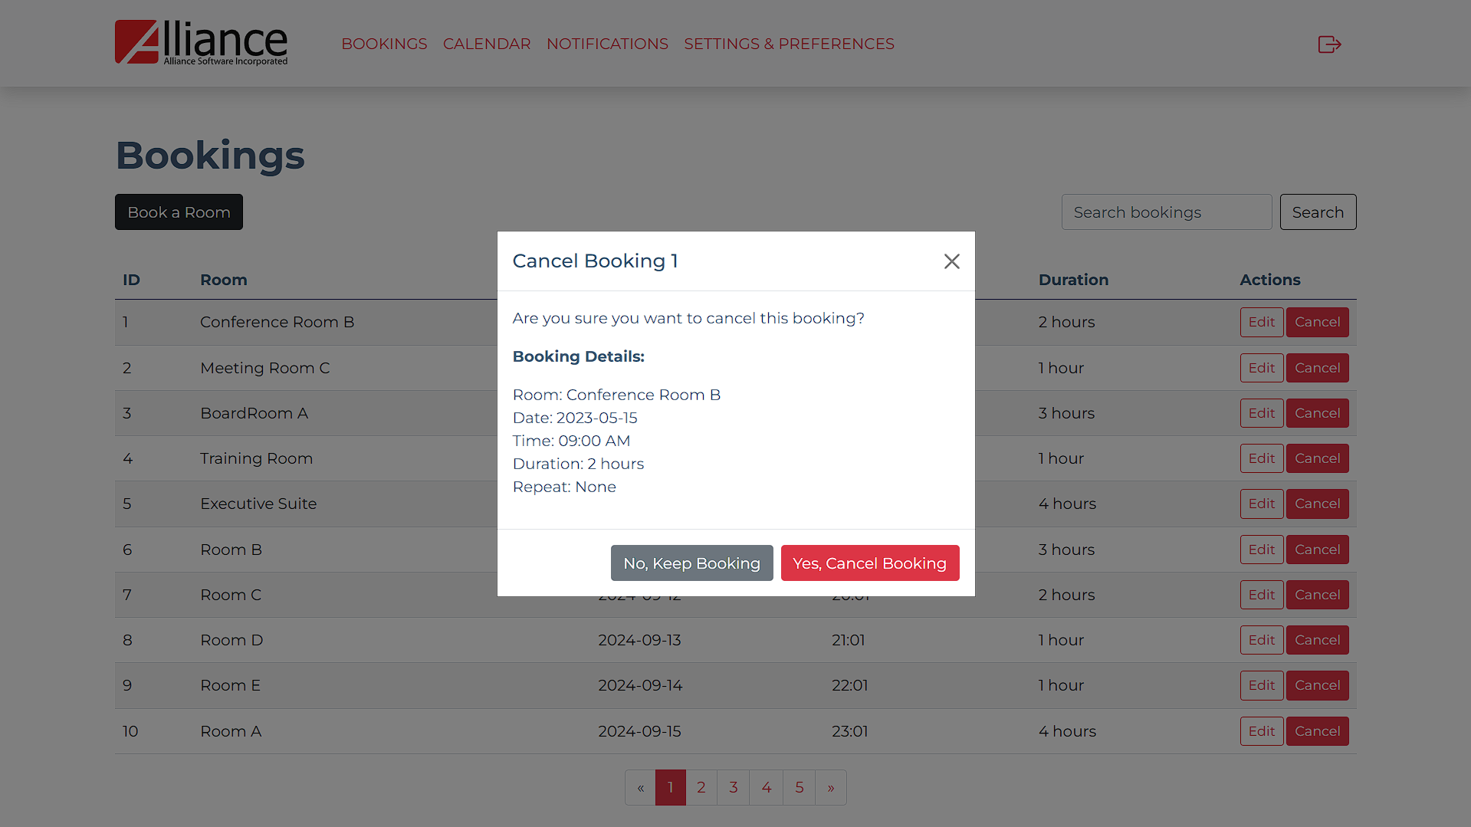
5.0 Cancel Booking

Slide 16
5.0 Cancel Booking Logic
Cancel Booking
Booking List
Select booking to cancel.
Cancel Button
Onclick
Display confirm cancellation modal:
Display message “Are you sure you want to cancel this booking?”
Yes, Cancel Booking Button
Onclick
Delete booking from the database.
Redirect to View Bookings Screen.
No, Keep Booking Button
Onclick
Close the modal without saving changes.

Slide 17
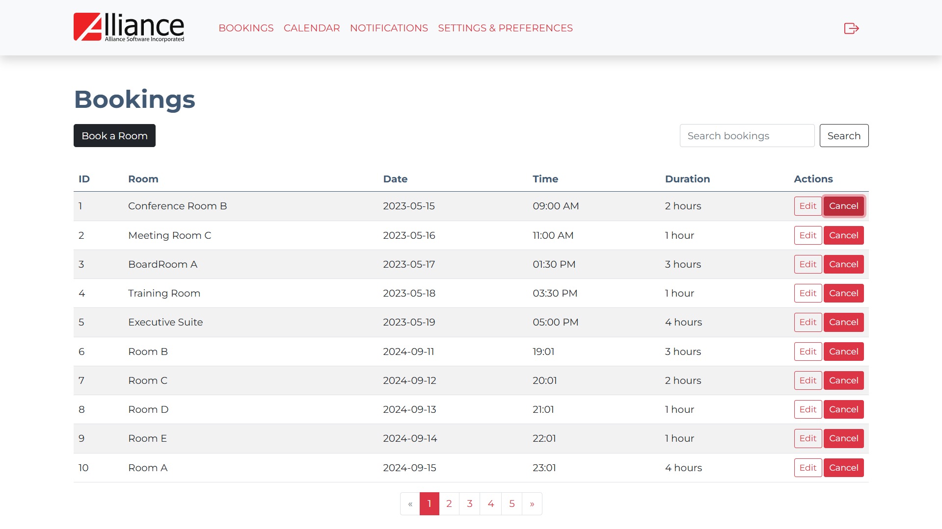
6.0 View Bookings

Slide 18
6.0 View Bookings Logic
View Bookings
Bookings List
Display all bookings with their details (ID, Room, Date, Time, Duration).
Actions:
Options to edit or cancel bookings.
Onclick
Redirect to respective screen (Edit Booking/Cancel Booking)

Slide 19
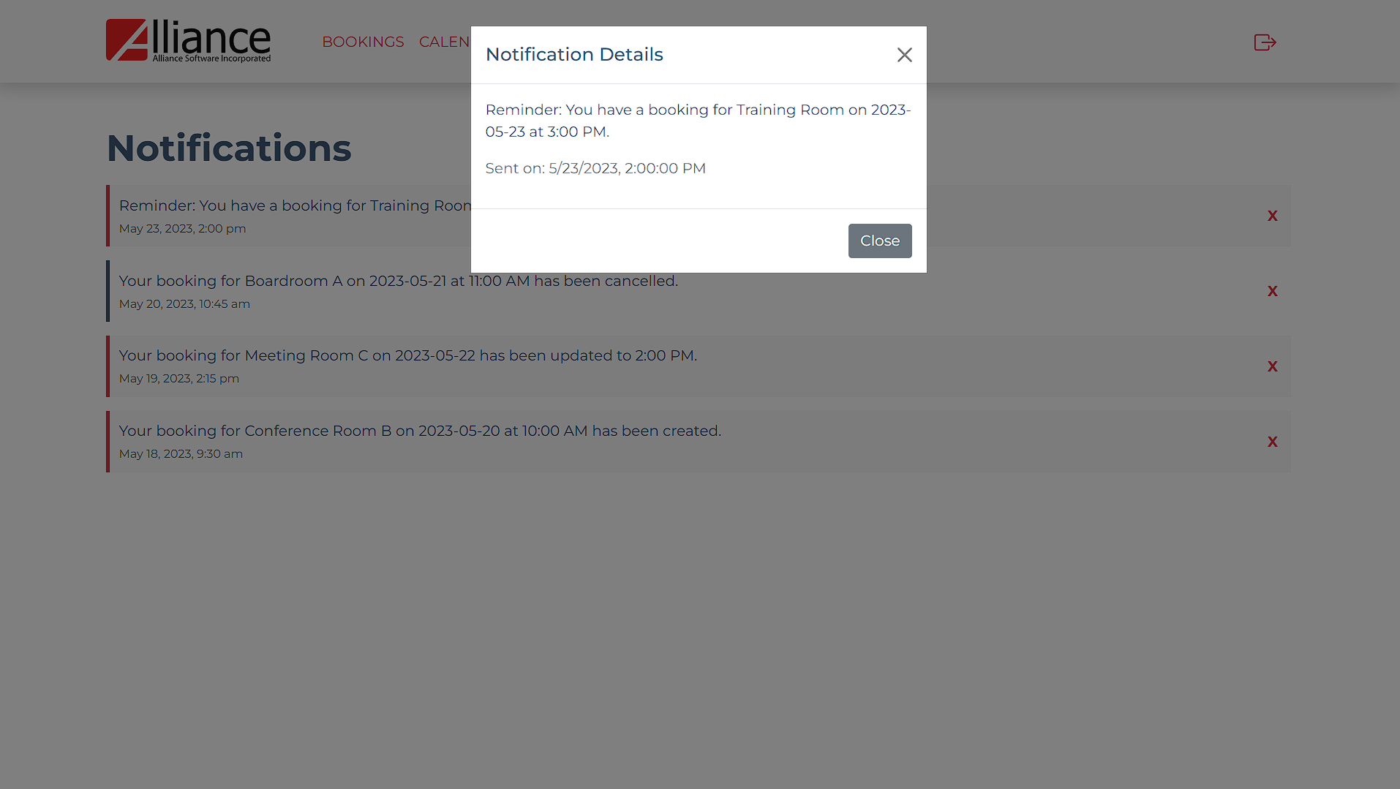
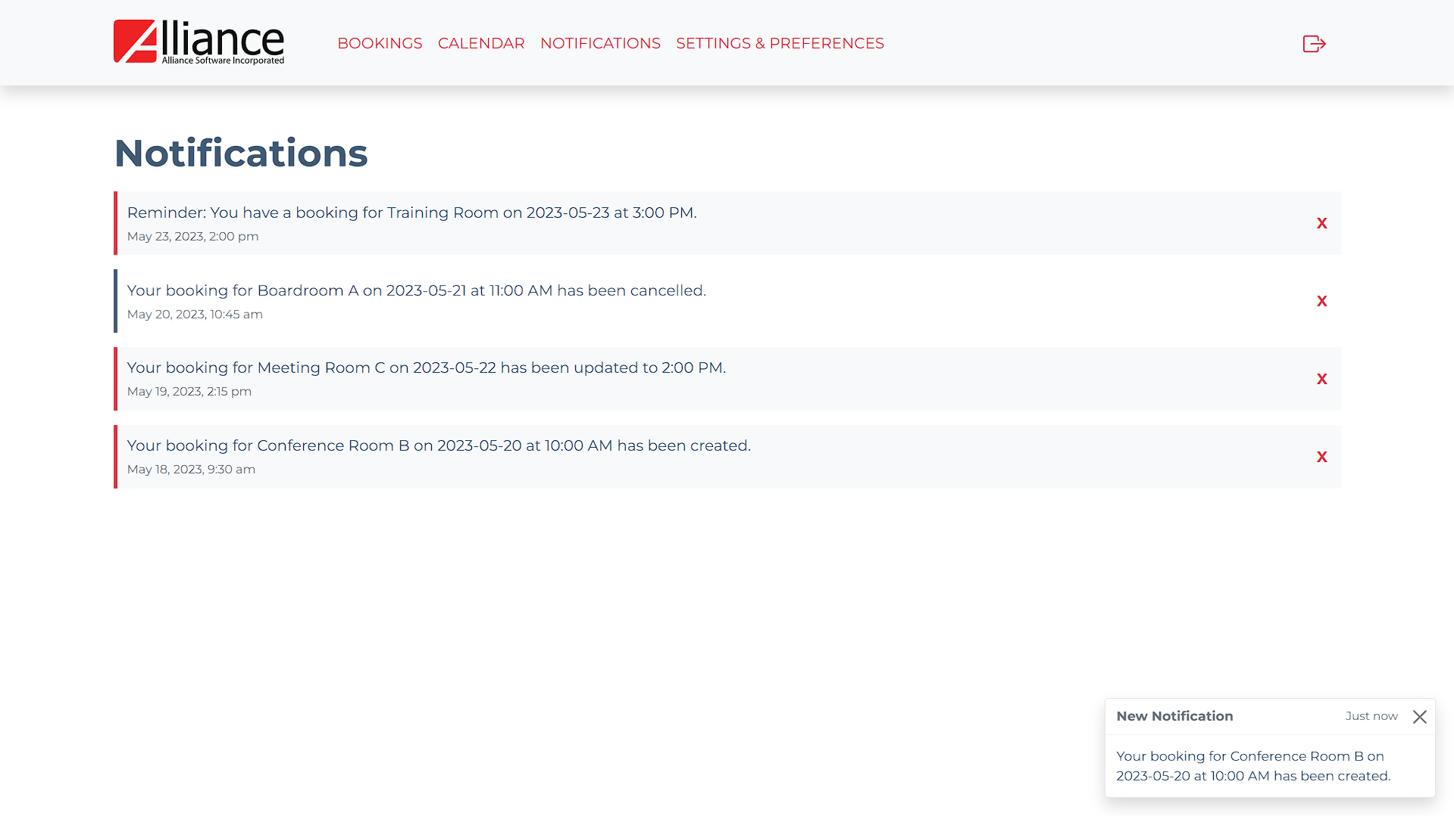

7.0 View Notifications

Slide 20
7.0 View Notifications Logic
View Notifications
Notifications List
Display a list of notifications (each notification contains a brief summary and timestamp). Each notification is clickable.
Notification
Onclick
Display modal with the full notification details (Notification Content, Timestamp).
Red X Icon
Onclick
Delete the notification.
Refresh the notification list to reflect the deletion.

Slide 21
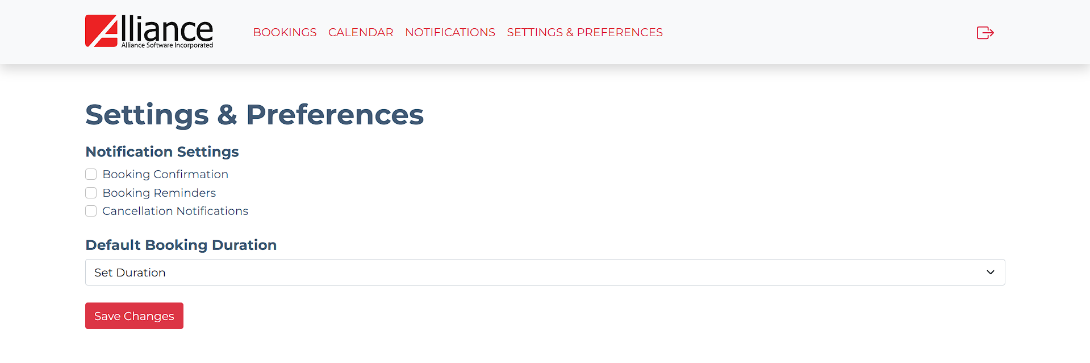
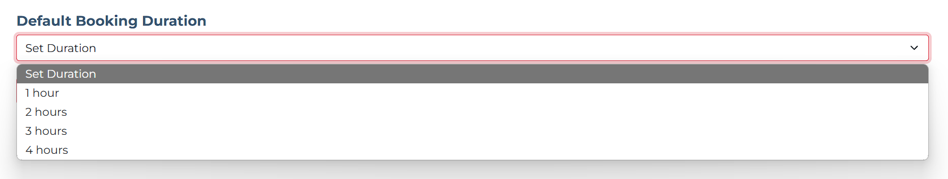
8.0 Settings and Preferences

Slide 22
8.0 Settings and Preferences Logic
Settings and Preferences
Notifications Settings
Booking Confirmation
Checkbox to enable/disable notifications for booking confirmations.
Booking Reminders
Checkbox to enable/disable notifications for booking reminders.
Cancellation Notifications
Checkbox to enable/disable notifications for booking cancellations.
Default Booking Duration
Dropdown to select default booking duration. Prefilled with the user's current default booking duration.
Save Changes Button
Onclick
Save the new notification settings and default booking duration to the database.

Slide 23
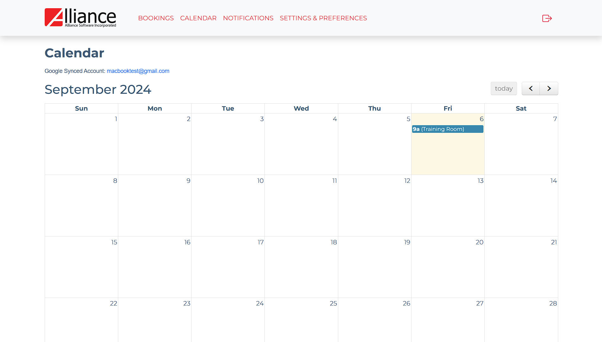
9.0 View Calendar

Slide 24
9.0 View Calendar Logic
View Calendar
Calendar Display
Show a monthly calendar view highlighting the user's booking.
Booked Dates
Dates with existing bookings are visually indicated (marked)
Available Dates
Dates without bookings are standard.
Date Click Interaction
Onclick of Any Date
Check if the date is in the past.
If in the past:
Display an error message: "Cannot create bookings for past dates.“
If today or future date:
Redirect to the Create Booking via Calendar screen with the selected date prefilled.

Slide 25
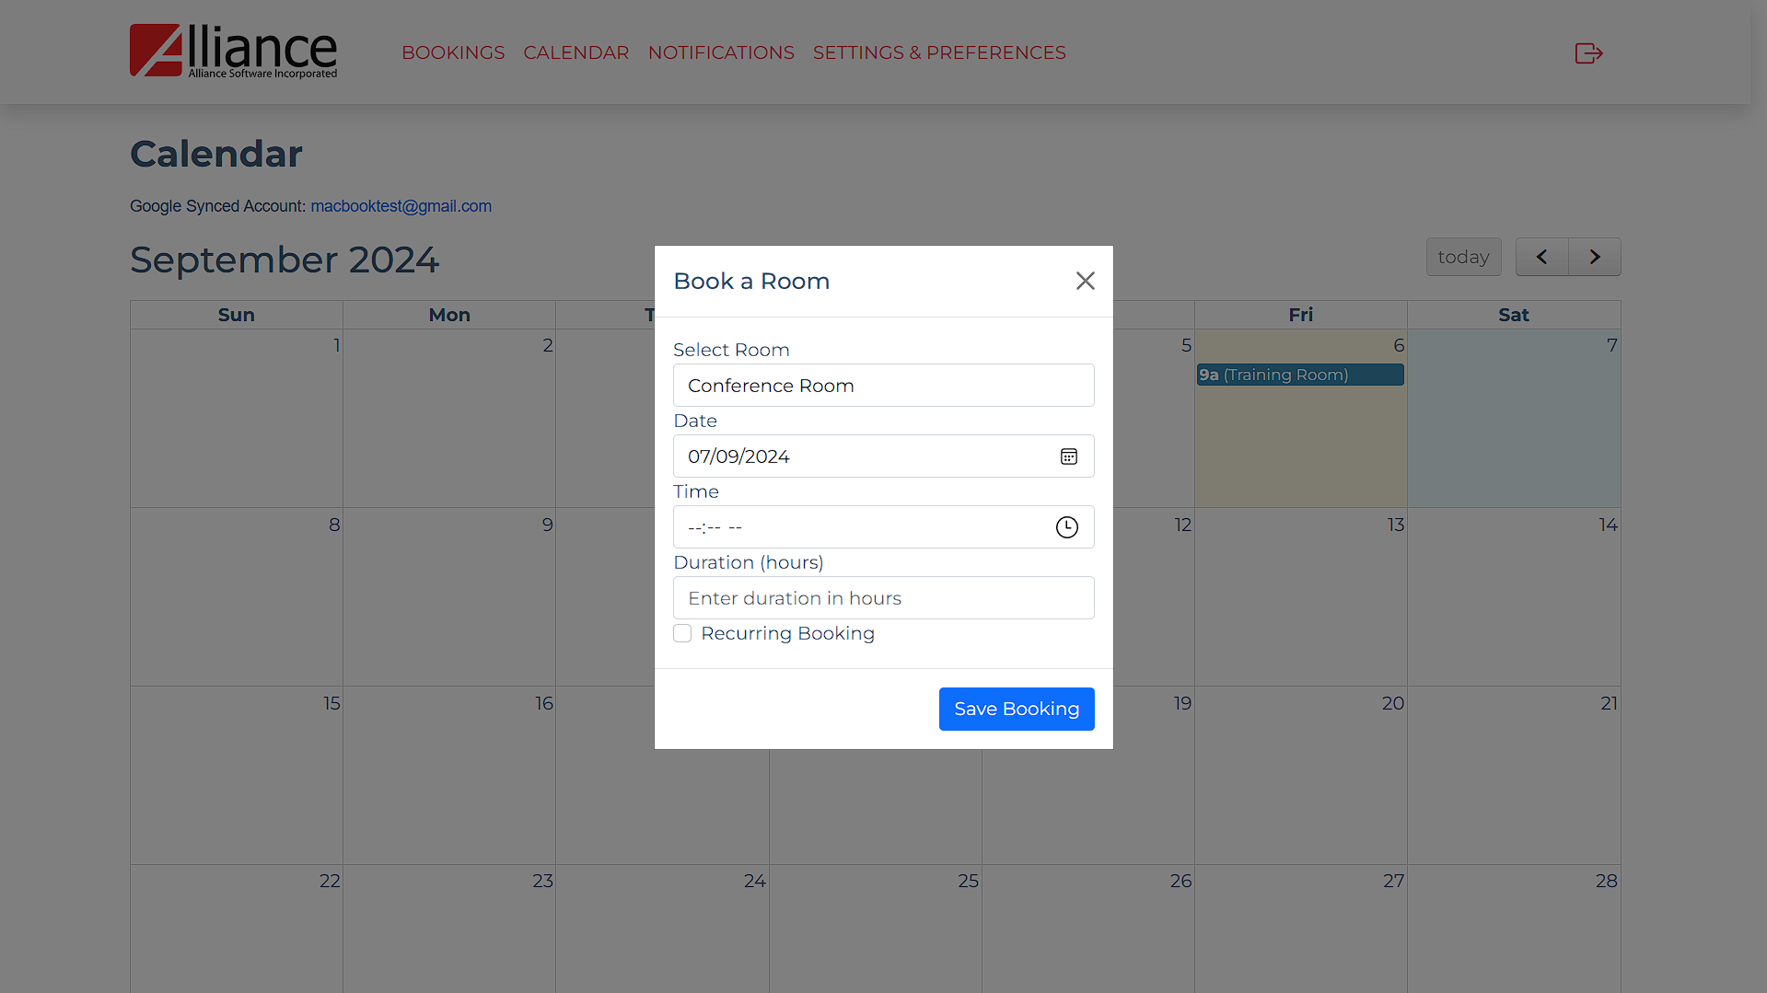
10.0 Create Booking via Calendar

Slide 26
10.0 Create Booking via Calendar Logic
Create Booking via Calendar
Calendar Date
Onclick
Display Create Booking Modal
Date
Input field for booking date, prefilled with the selected date from the calendar.
Select Room
Dropdown to choose a room.
Time
Input field for booking time.
Duration
Input field for booking duration.
Recurring Booking Checkbox
Checkbox with label "Recurring booking.“
If checked, display additional inputs
Repeat
Dropdown with options: Daily, Weekly, Monthly.
Until
Date input for the end date of the recurring booking.
Book Room Button
Onclick
Check if required fields are empty.
Display error message "All fields are required.“
If recurring booking is selected
Validate the repeat frequency and end date. Ensure the "Until" date is after the selected booking date.
If all validations pass:
Save booking details.
Close the modal and refresh the calendar to reflect the new booking.
Cancel Button
Onclick
Close the modal without saving changes.

Slide 27
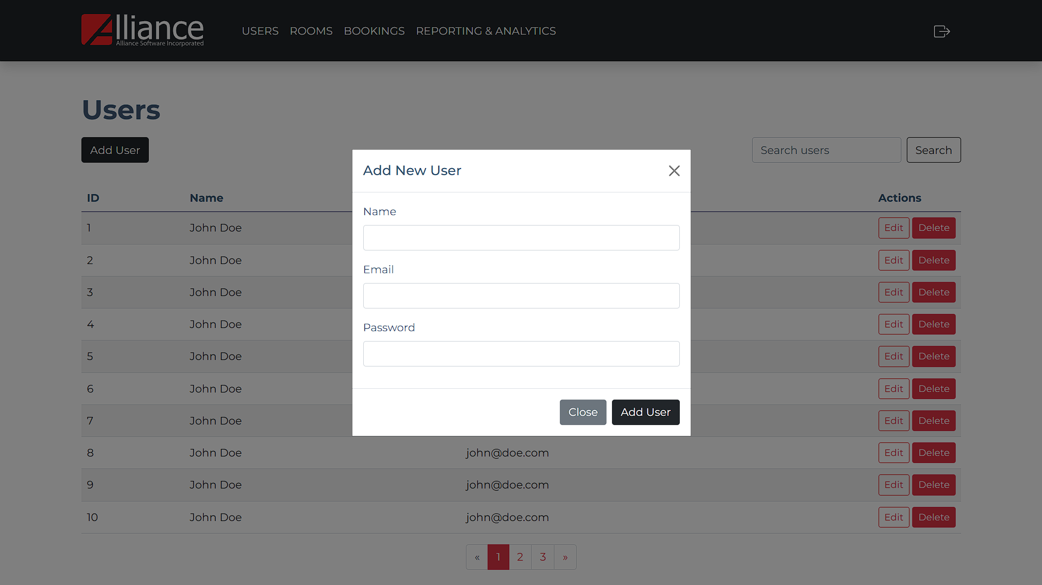
11.0 Add User

Slide 28
11.0 Add User Logic
Add User
Add User Button
Onclick
Display modal to input user details:
Name
Input field for user's name.
Email
Input field for user's email.
Password
Input field for user's password (masked characters).
Add User Button
Onclick
Check if required fields are empty.
Display error message: "All fields are required.“
If email is already in use:
Display error message: "Email is already registered.“
If all validations pass:
Save user details to the database.
Close the modal and refresh the View Users Screen.
Close Button
Onclick
Close the modal without saving changes.

Slide 29
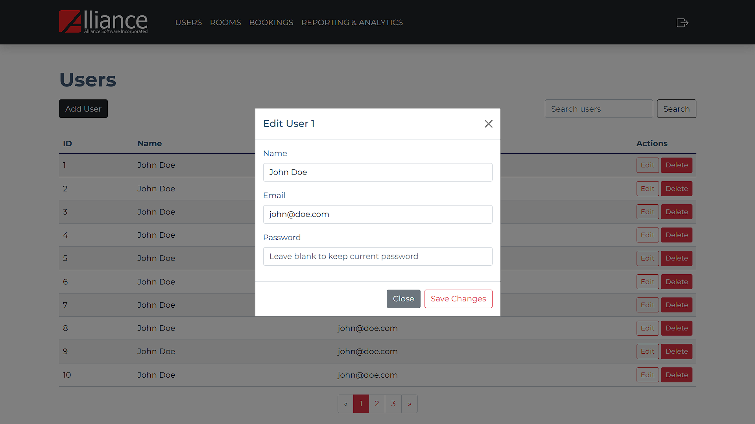
12.0 Edit User

Slide 30
12.0 Edit User Logic
Edit User
User List
Select user to edit.
Edit Button
Onclick
Display modal to update user details:
Name
Input field for user's name. (prefilled)
Email
Input field for user's email. (prefilled)
Password
Input field for user's password (optional, masked characters).
Save Changes Button
Onclick
Check if required fields are empty.
Display error message: "All fields are required.“
If changing email and new email is already in use:
Display error message: "Email is already registered.“
If all validations pass:
Update user details in the database.
Redirect to View Users Screen.
Close Button
Onclick
Close the modal without saving changes.

Slide 31
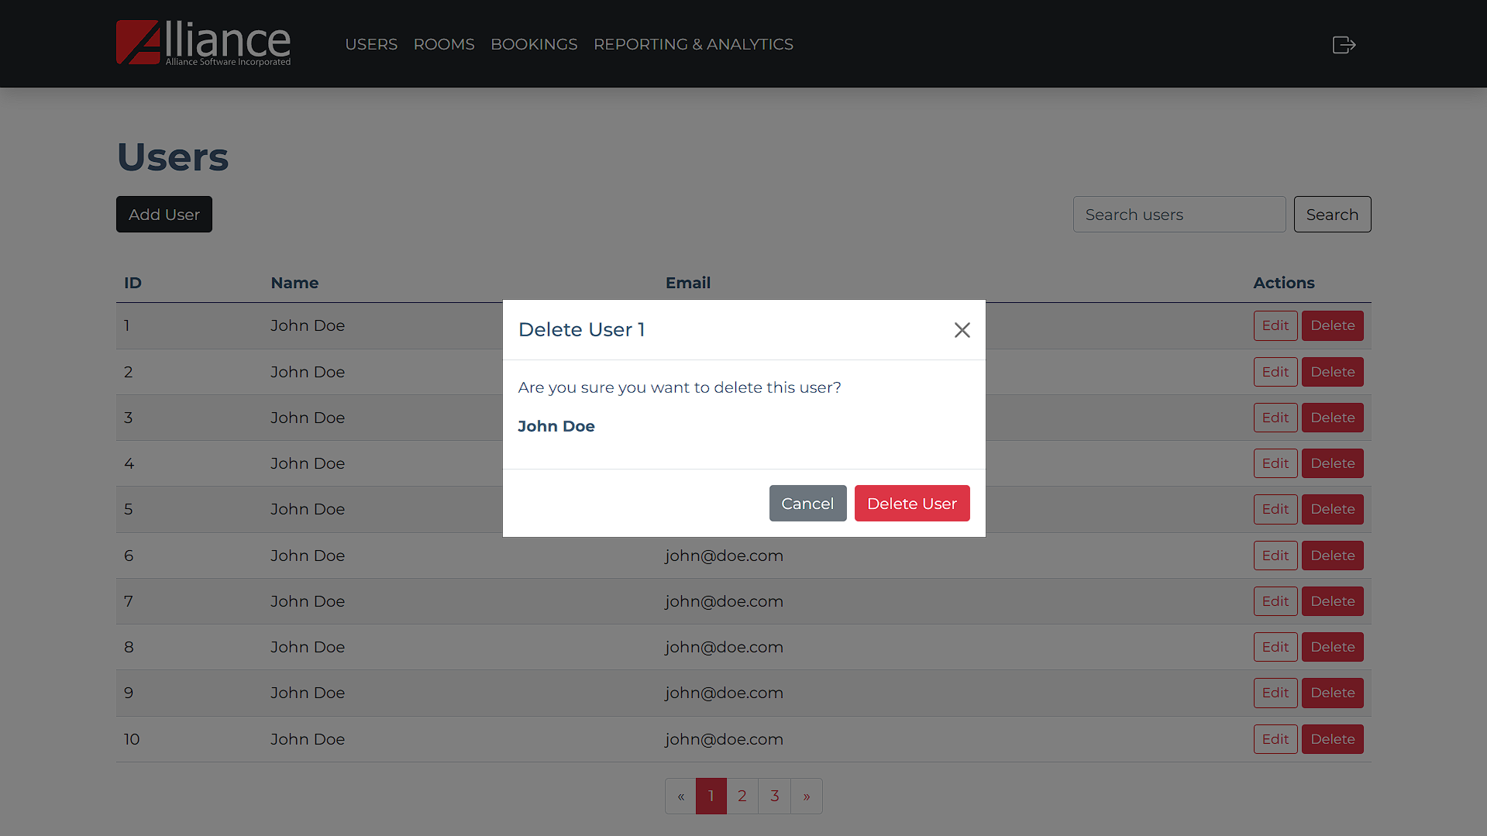
13.0 Delete User

Slide 32
13.0 Delete User Logic
Delete User
User List
Select user to delete.
Delete Button
Onclick
Display confirm deletion modal:
Display message “Are you sure you want to delete this user?”
Delete User Button
Onclick
Delete user from the database.
Redirect to View Users Screen.
Cancel Button
Onclick
Close the modal.

Slide 33
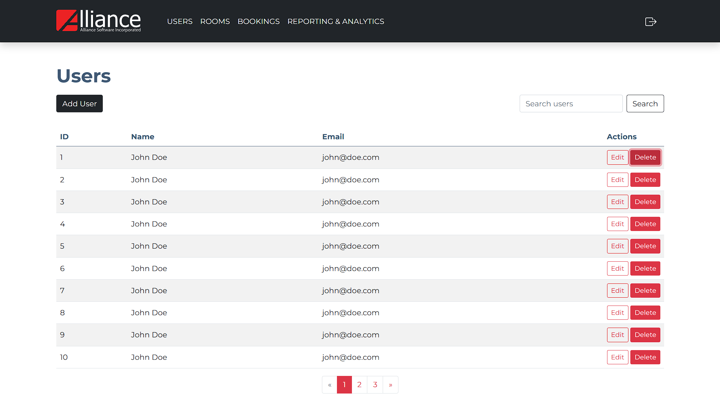
14.0 View Users

Slide 34
14.0 View Users Logic
View Users
User List
Display all users with their details (ID, name, email).
Actions:
Options to edit or delete users.
Onclick
Redirect to respective screen (Edit User/Delete User)

Slide 35
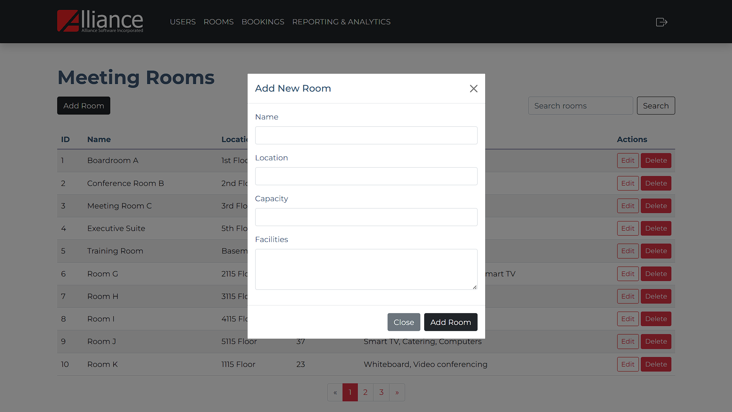
15.0 Add Room

Slide 36
15.0 Add Room Logic
Add Room
Add Room Button
Onclick
Display modal to input room details:
Room Name
Input field for room name.
Location
Input field for room location.
Capacity
Input field for room capacity.
Facilities
Input field for available facilities.
Add Room Button
Onclick
Check if required fields are empty.
Display error message: "All fields are required.“
Close the modal and refresh the View Rooms Screen.
Close Button
Onclick
Close the modal without saving changes.

Slide 37
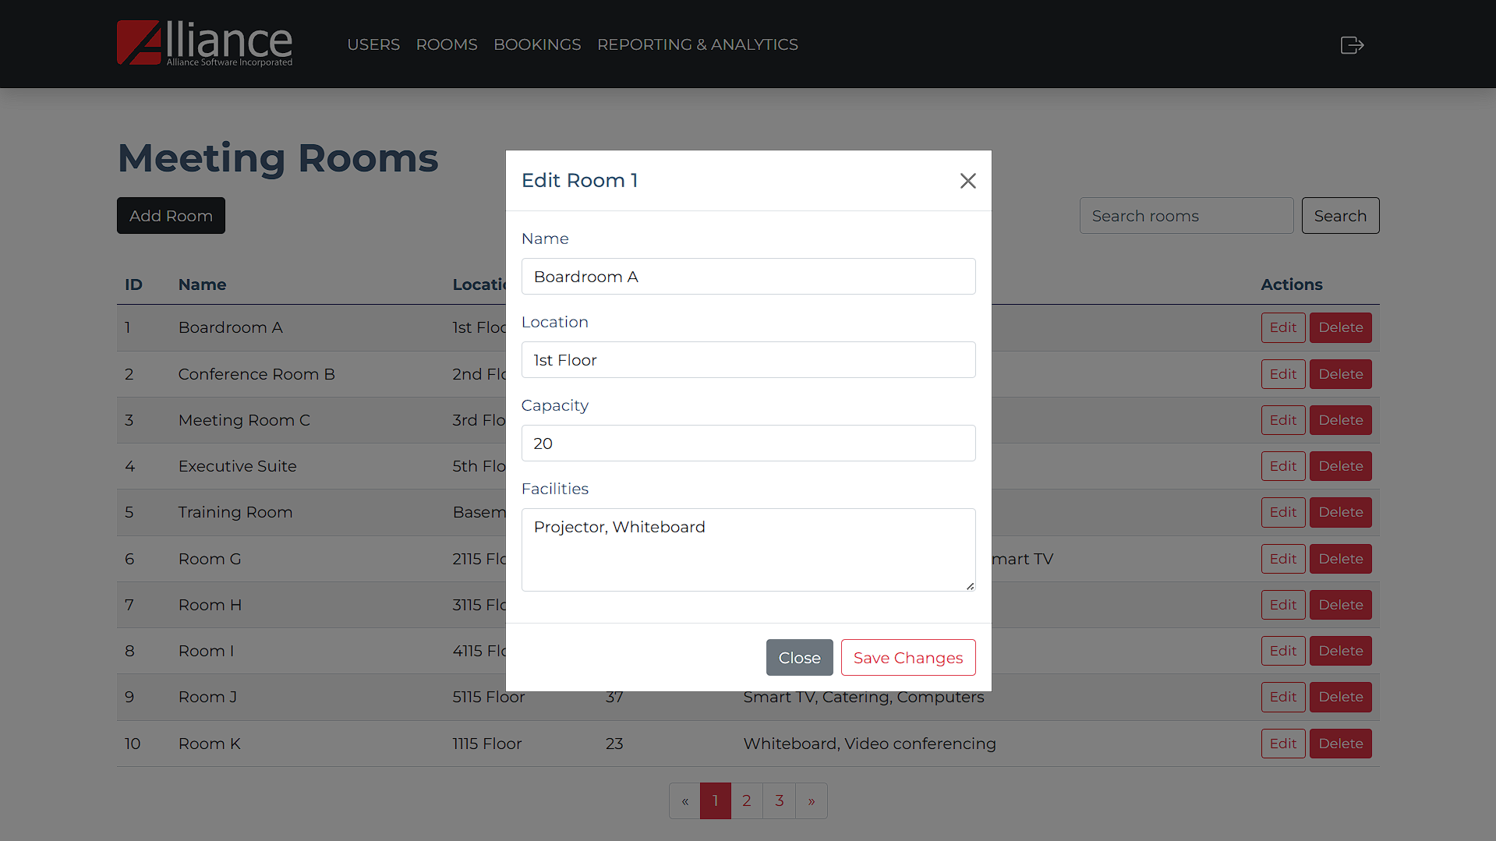
16.0 Edit Room

Slide 38
16.0 Edit Room Logic
Edit Room
Room List
Select room to edit.
Edit Button
Onclick
Display modal to update room details:
Room Name
Input field for room name (prefilled).
Location
Input field for room location (prefilled).
Capacity
Input field for room capacity (prefilled).
Facilities
Input field for available facilities (prefilled).
Save Changes Button
Onclick
Check if required fields are empty.
Display error message "All fields are required.“
If all validations pass:
Update room details in the database.
Redirect to View Rooms Screen.
Close Button
Onclick
Close the modal without saving changes.

Slide 39
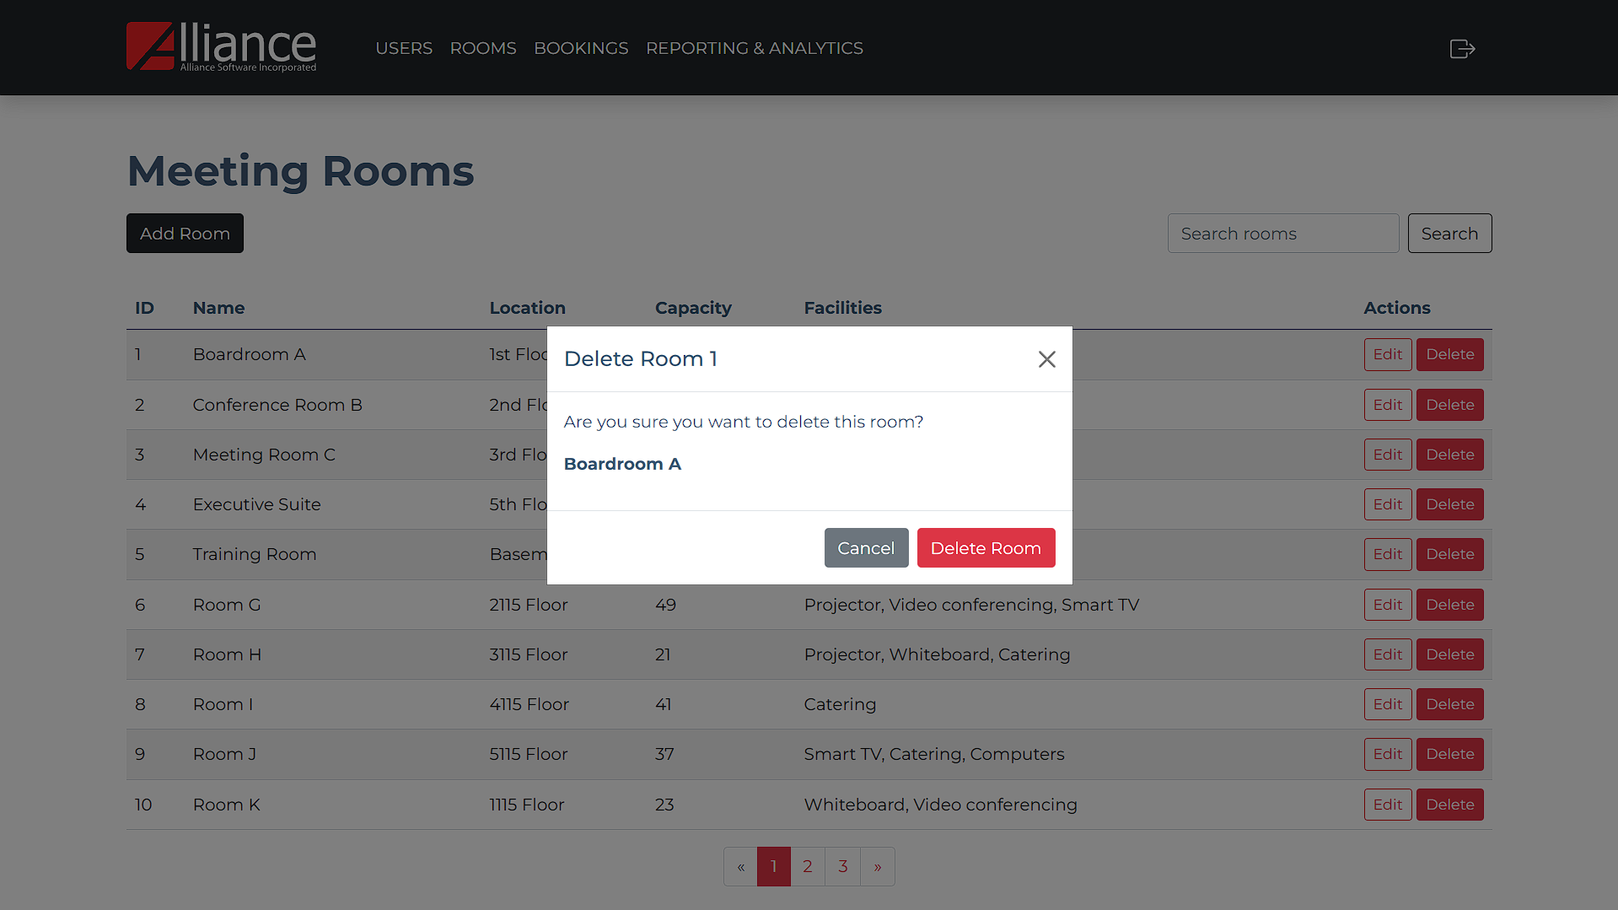
17.0 Delete Room

Slide 40
17.0 Delete Room Logic
Delete Room
User List
Select room to delete.
Delete Button
Onclick
Display confirm deletion modal:
Display message “Are you sure you want to delete this room?”
Delete Room Button
Onclick
Delete room from the database.
Redirect to View Users Screen.
Cancel Button
Onclick
Close the modal.

Slide 41
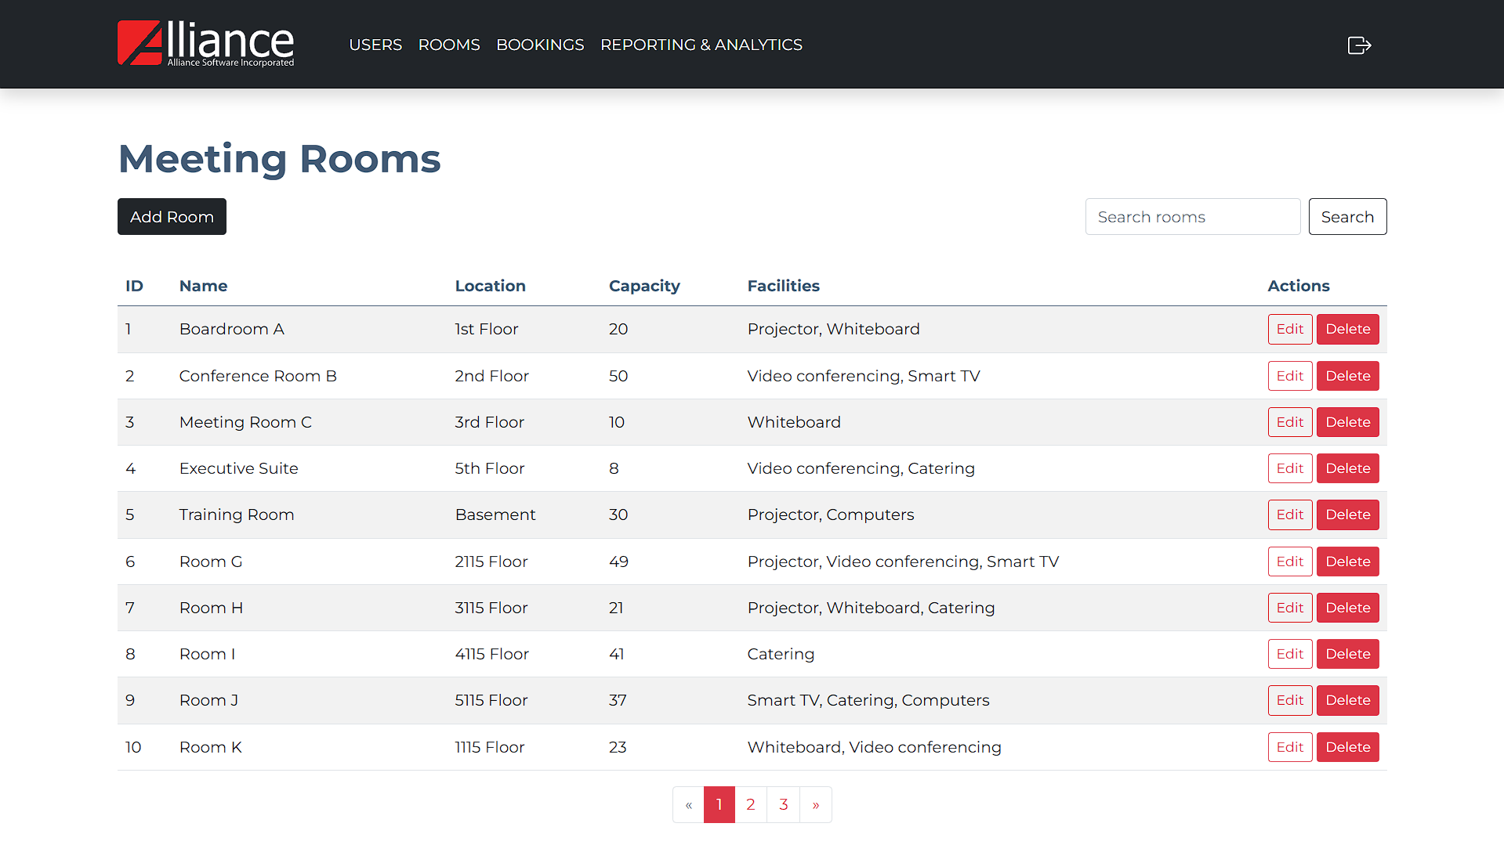
18.0 View Rooms

Slide 42
18.0 View Rooms Logic
View Rooms
Room List
Display all rooms with their details (name, location, capacity, facilities).
Actions:
Options to edit or delete rooms.
Onclick
Redirect to respective screen (Edit Room/Delete Room)

Slide 43
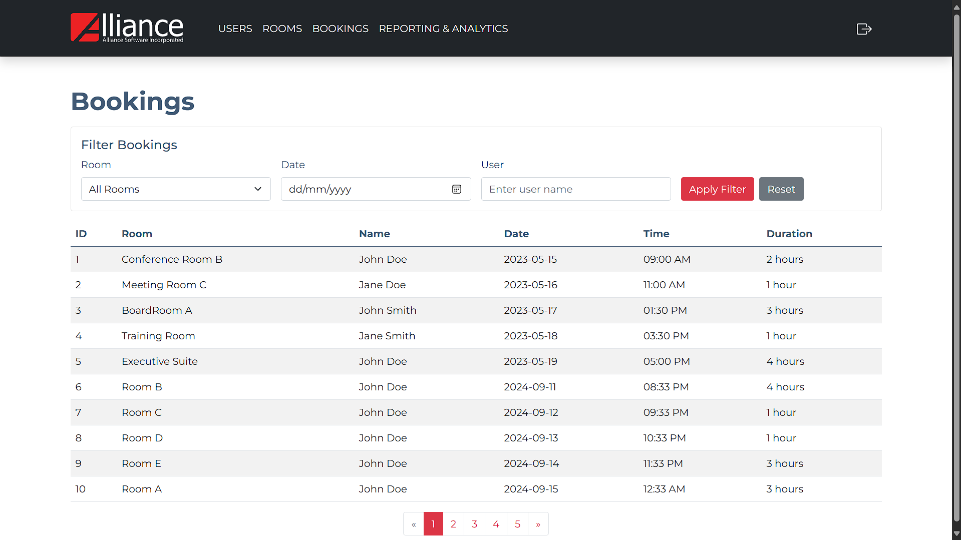
19.0 Booking Summary

Slide 44
19.0 Booking Summary Logic
View Bookings
Filter Bookings
Room
On selection
Filter bookings by selected room.
Date
On date selection
Filter bookings by selected date.
User
On user name input
Filter bookings by matching the entered user name.
Apply Filter Button
Onclick
Apply all selected filters (Room, Date, User).
Display filtered results in the bookings list.
Reset Button
Onclick
Clear all filters (Room, Date, User).
Display all bookings without any filtering.
Booking List
Display all bookings with details (id, room, date, time, user).

Slide 45
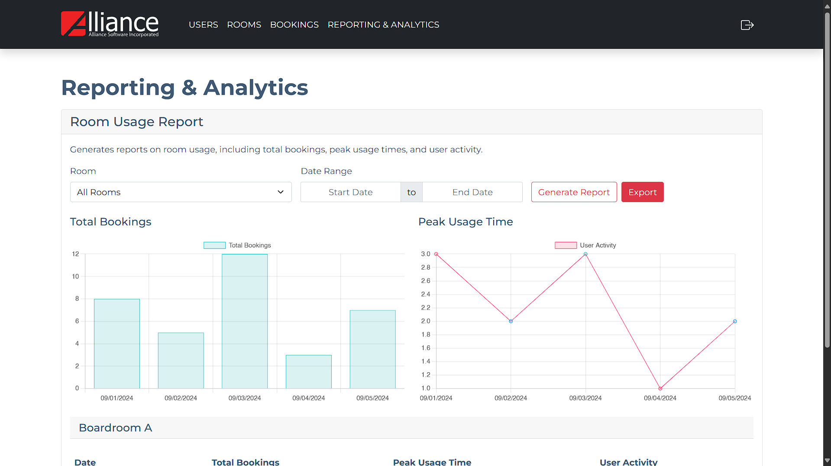
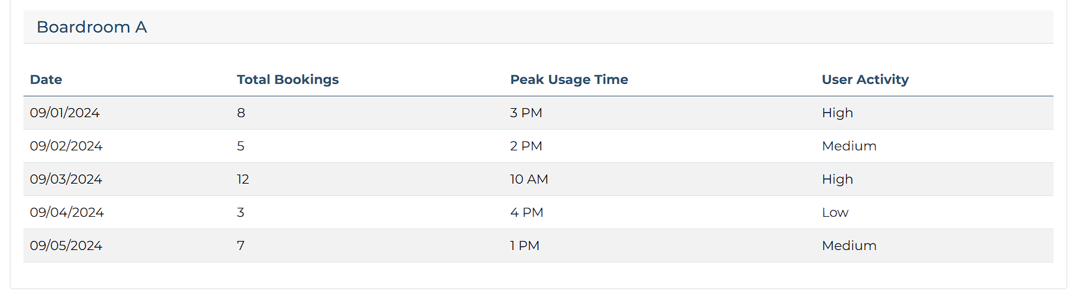
20.0 Room Usage Report

Slide 46
20.0 Room Usage Report Logic
Room Usage Report
Filters for Report Generation
Rooms Dropdown
On selection
Filter bookings by selected room.
Date Range Picker
Start Date: Select the starting date for the report.
End Date: Select the ending date for the report.
Generate Report Button
Onclick
Validate that both the date range and room selection are provided.
If invalid (e.g., Start Date after End Date)
Display an error message: "Invalid date range.“
If valid
Proceed to generate the report based on the selected filters.
Display the total bookings and peak usage time charts.
Display the room usage report table based on the filtered data.
Export Button
Onclick
Export the generated report (filtered data, charts, and table) to a file (CSV or PDF).

Slide 47
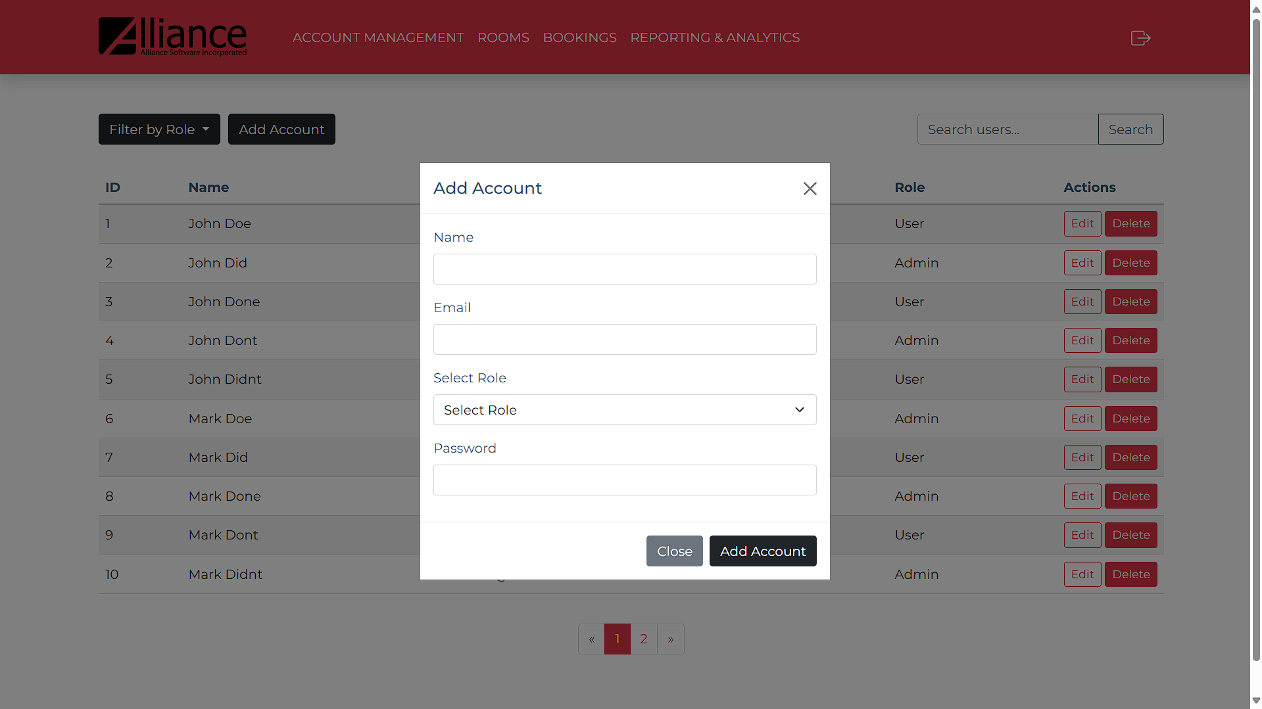
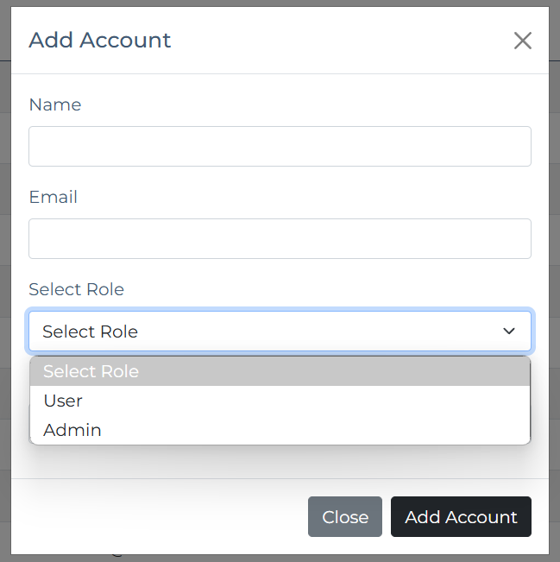
21.0 Add Account - Superadmin

Slide 48
21.0 Add Account – Superadmin Logic
Add Account - Superadmin
Add Account Button
Onclick
Display modal to input user details:
Name
Input field for user's name.
Email
Input field for user's email.
Role
Dropdown to select user role (Admin, User).
Password
Input field for user's password (masked characters).
Add User Button
Onclick
Check if required fields are empty.
Display error message: "All fields are required.“
If email is already in use:
Display error message: "Email is already registered.“
If all validations pass:
Save user details to the database.
Close the modal and refresh the View Accounts Screen.
Close Button
Onclick
Close the modal without saving changes.

Slide 49
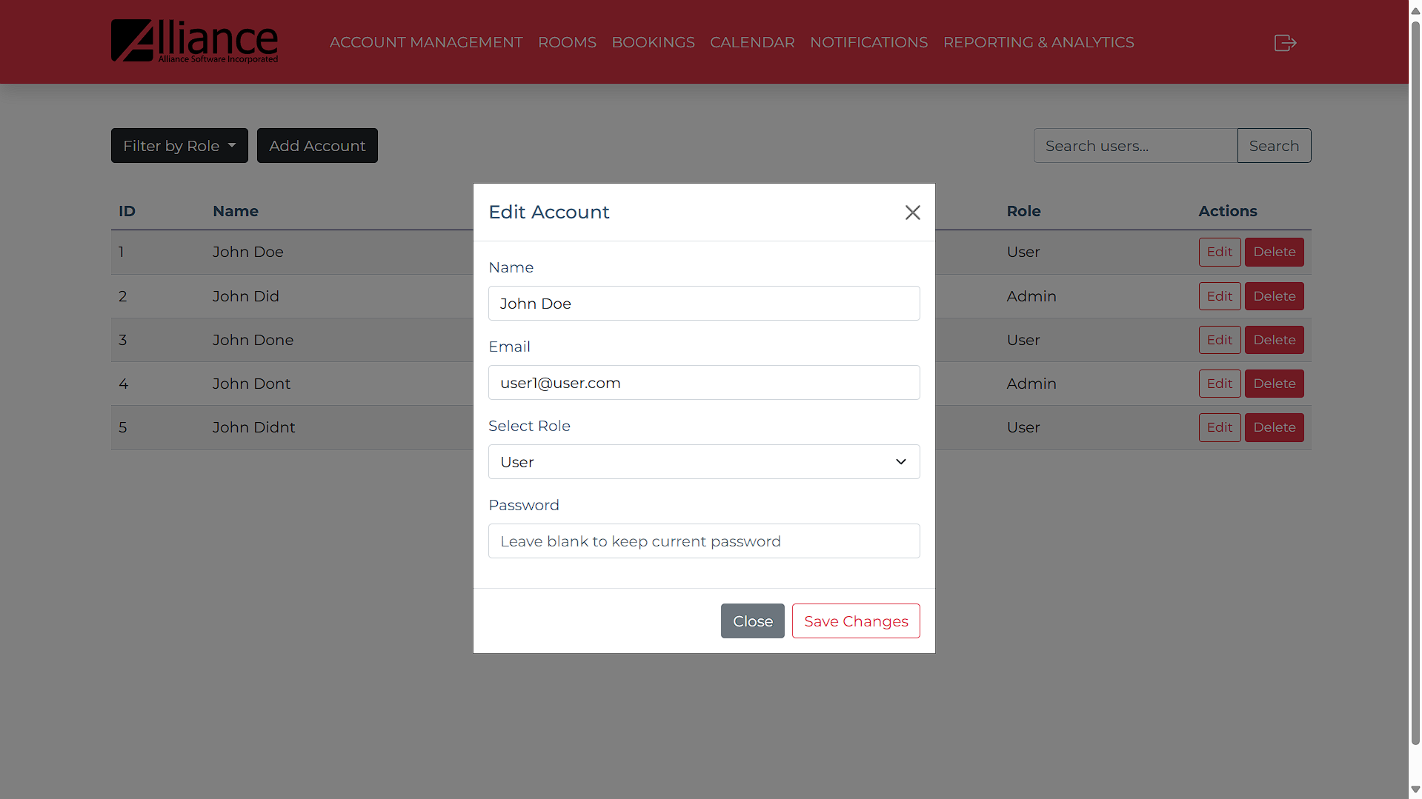
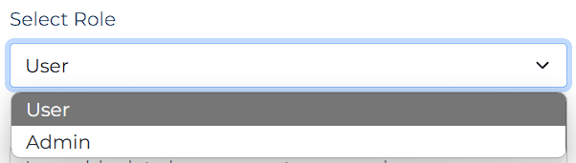
22.0 Edit Account - Superadmin

Slide 50
22.0 Edit Account – Superadmin Logic
Edit Account
User List
Select user to edit.
Edit Button
Onclick
Display modal to update user details:
Name
Input field for user's name. (prefilled)
Email
Input field for user's email. (prefilled)
Role
Dropdown to change user role (Admin, User).
Password
Input field for user's password (optional, masked characters).
Save Changes Button
Onclick
Check if required fields are empty.
Display error message: "All fields are required.“
If changing email and new email is already in use:
Display error message: "Email is already registered.“
If all validations pass:
Update user details in the database.
Redirect to View Accounts Screen.
Close Button
Onclick
Close the modal without saving changes.

Slide 51
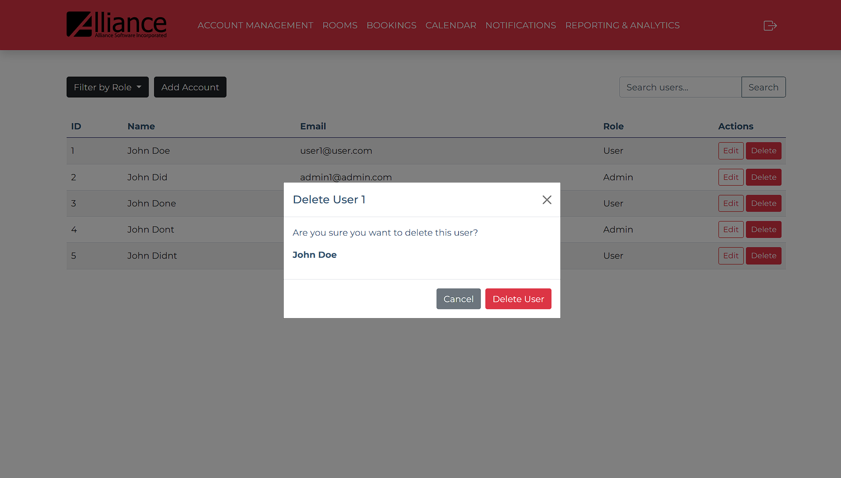
23.0 Delete Account - Superadmin

Slide 52
23.0 Delete Account – Superadmin Logic
Delete Account
User List
Select user to delete.
Delete Button
Onclick
Display confirm deletion modal:
Display message “Are you sure you want to delete this user?”
Delete User Button
Onclick
Delete user from the database.
Redirect to View Accounts Screen.
Cancel Button
Onclick
Close the modal.

Slide 53
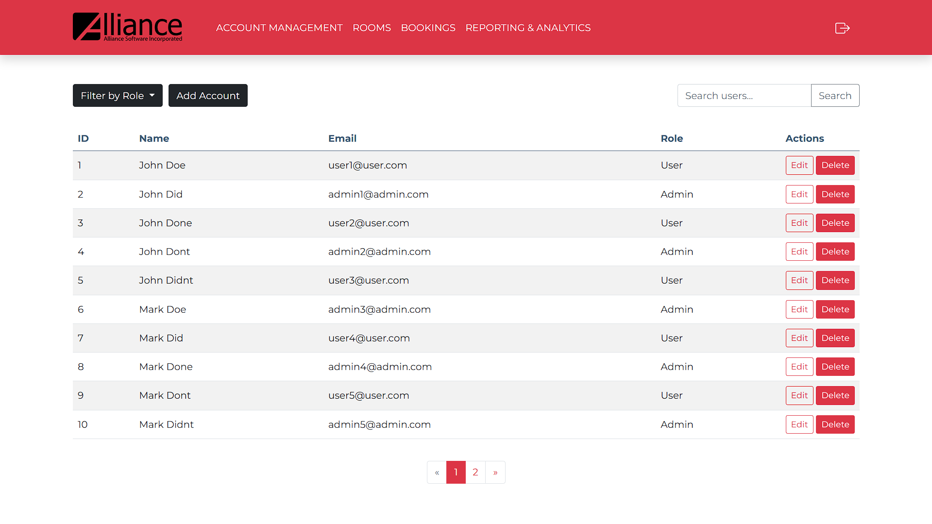
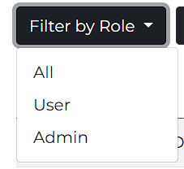
24.0 View Accounts - Superadmin

Slide 54
24.0 View Account – Superadmin Logic
View Accounts
User List
Display all users with their details (name, email, role).
Actions:
Options to edit or delete users.
Onclick
Redirect to respective screen (Edit User/Delete User)

Slide 55
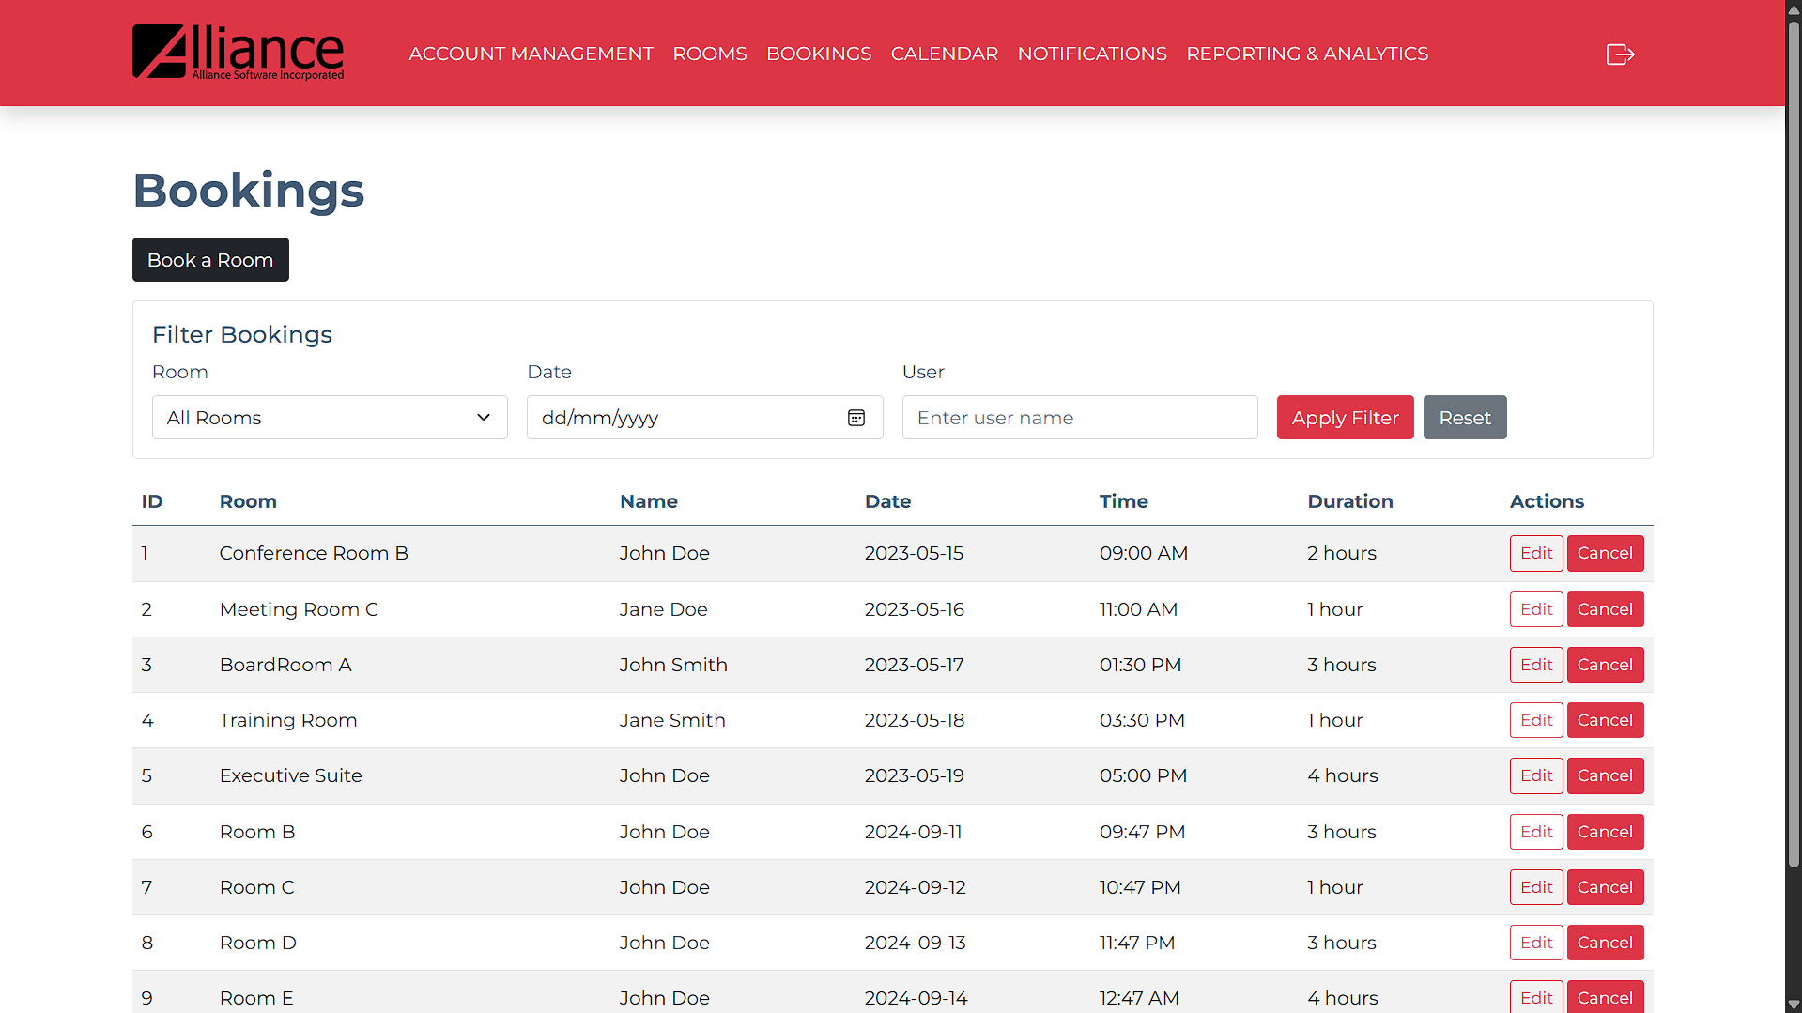
25.0 View Bookings - Superadmin

Slide 56
25.0 View Bookings – Superadmin Logic
View Bookings
Filter Bookings
Room
On selection
Filter bookings by selected room.
Date
On date selection
Filter bookings by selected date.
User
On user name input
Filter bookings by matching the entered user name.
Apply Filter Button
Onclick
Apply all selected filters (Room, Date, User).
Display filtered results in the bookings list.
Reset Button
Onclick
Clear all filters (Room, Date, User).
Display all bookings without any filtering.
Booking List
Display all bookings with details (ID, room, date, time, user).
Book a Room Button
Onclick
Redirect to Create Booking/Recurring Booking screen
Actions
Options to edit or delete bookings.
Onclick
Redirect to respective screen (Edit Booking/Delete Booking)

Slide 57


